Slide 1
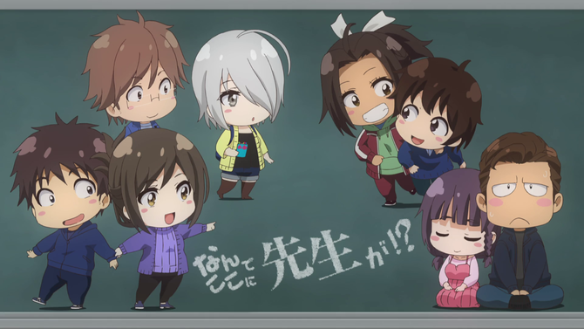
Jersey Scans
By: Team Hentai (Benjamin Padmore and Nicco Toral)

Slide 2

Purpose of Website
The purpose/description of this website is to display and offer comics like manga, manhwa, and manhua to read

Slide 3
List of technologies used
The technologies that were used are
HTML- Creating the pages and adding in the manga, manhwa, and manhua
CSS- Creating the basic background of each page, and using divs for the header, and the other reading materials
Javascript- Making the slideshow on the front of our homepage and alerts for people to login before access the reading
PHP- Using PHP to get the form of the Username, Password, Comments, and the admin page
SQL- Implementing a Database for the comments, usernames, passwords and the admin page.

Slide 4
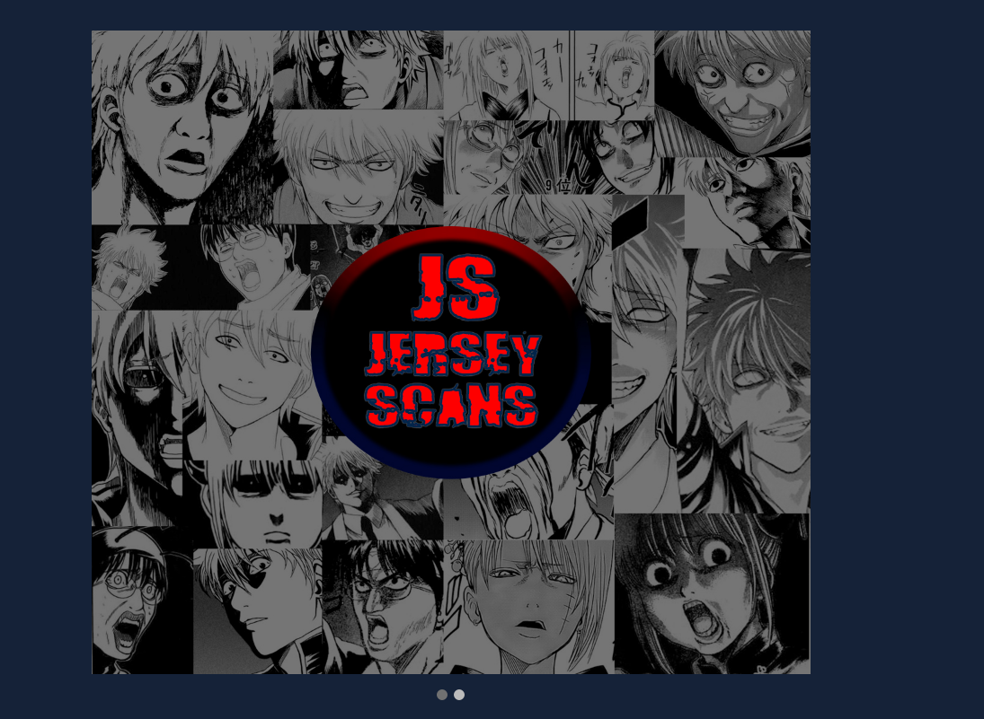
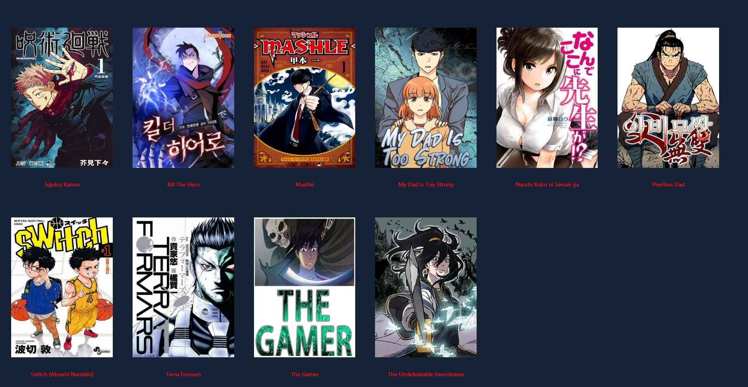
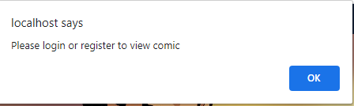
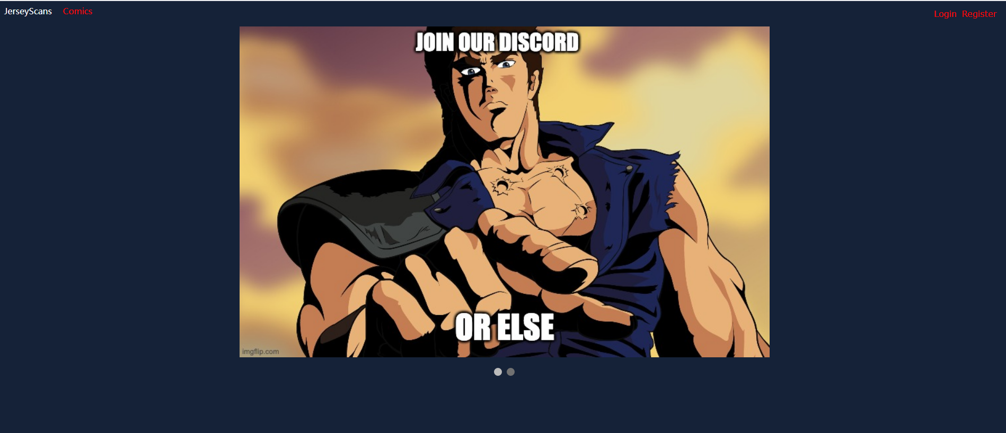
Index

Slide 5
Index (Con).
This is the home page or the index of the Jersey Scans website.
We included in the index a slideshow where it shows the Jersey Scans logo and another image of joining our Discord dedicated to the website.
Here on the index we also have the list of readings we currently have
Whenever a user tries to open a comic they are greeted with an alert that have to login and register in order to access the Manga
Which is why the login and register links are there on the right.
Click on the Jersey Scans or Comics will lead back to the home page

Slide 6
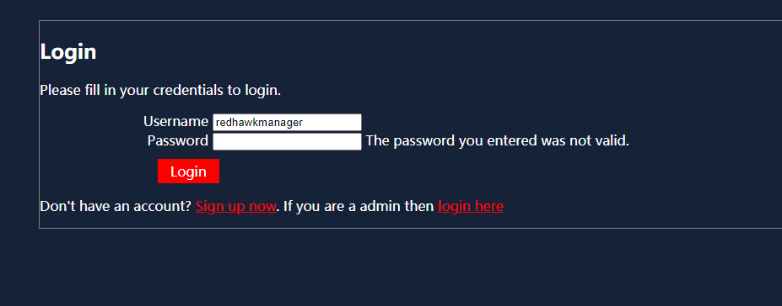
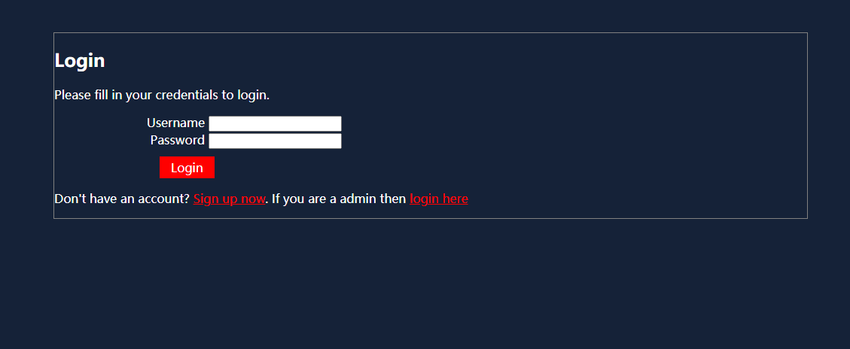
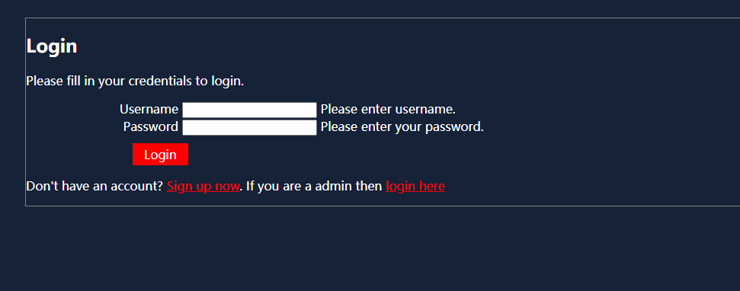
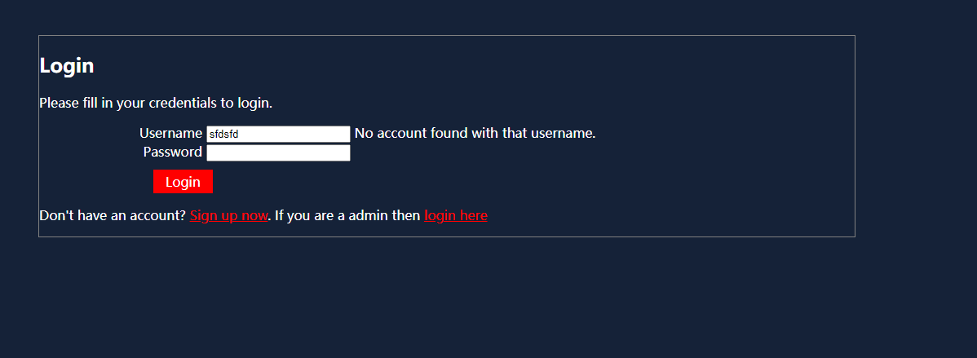
Login Page

Slide 7
Login Page (Con).
From the Index, the user can go into the login page to try and log into their account.
If the user enters nothing the website will tell them to enter a username or password and if they are missing either or it would still to enter the missing field
If a user enters a username and password but it is not currently in the database then, it will return with saying there is no account with that name
Finally, if the user tries to get in but puts in the wrong password it will say it’s not valid

Slide 8
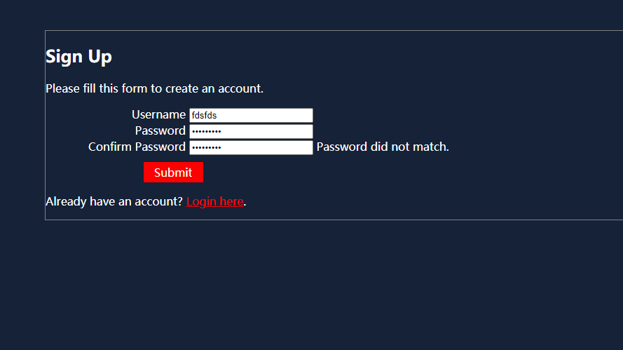
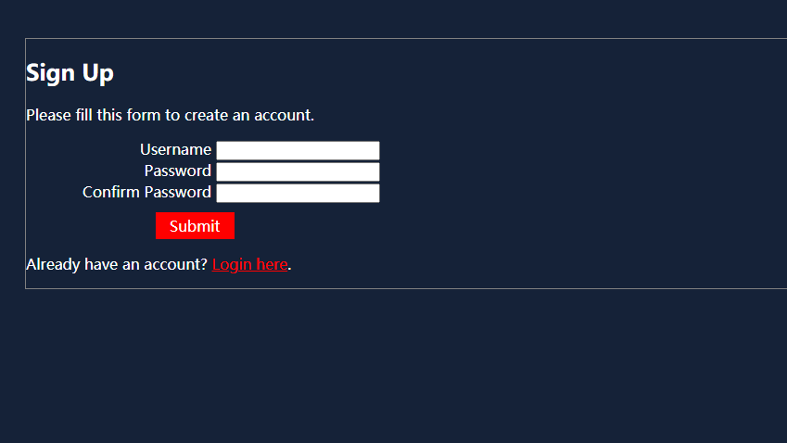
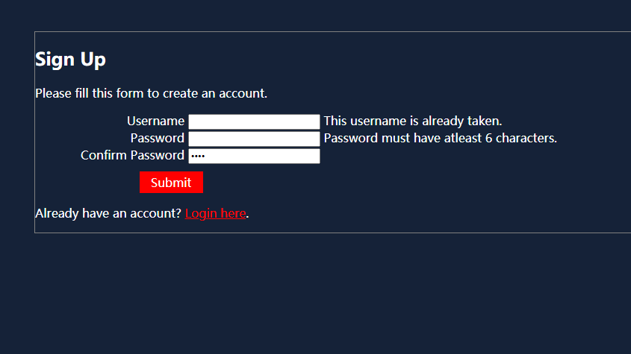
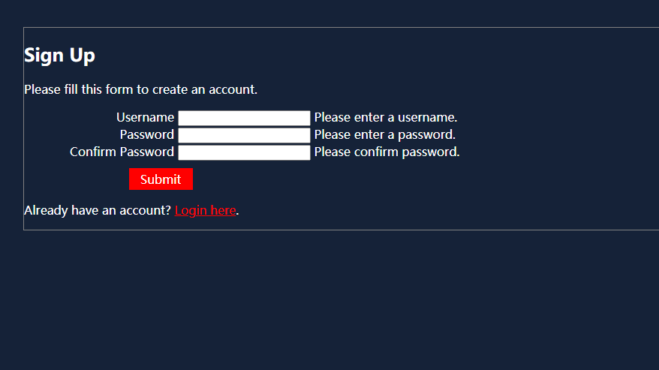
Register Page

Slide 9
Register Page (Con).
User can create an account through the register page. They can connect to it via from the Index or the Sign in Page
It has similar properties as the sign in page, if the user doesn’t enter the required fields the website tells them to enter in the field.
If the user puts a unique password but if the user does not match the password the website doesn’t allow the account to be created
The same also applies if the user puts in a username that’s already taken or if the password is not at least 6 characters

Slide 10
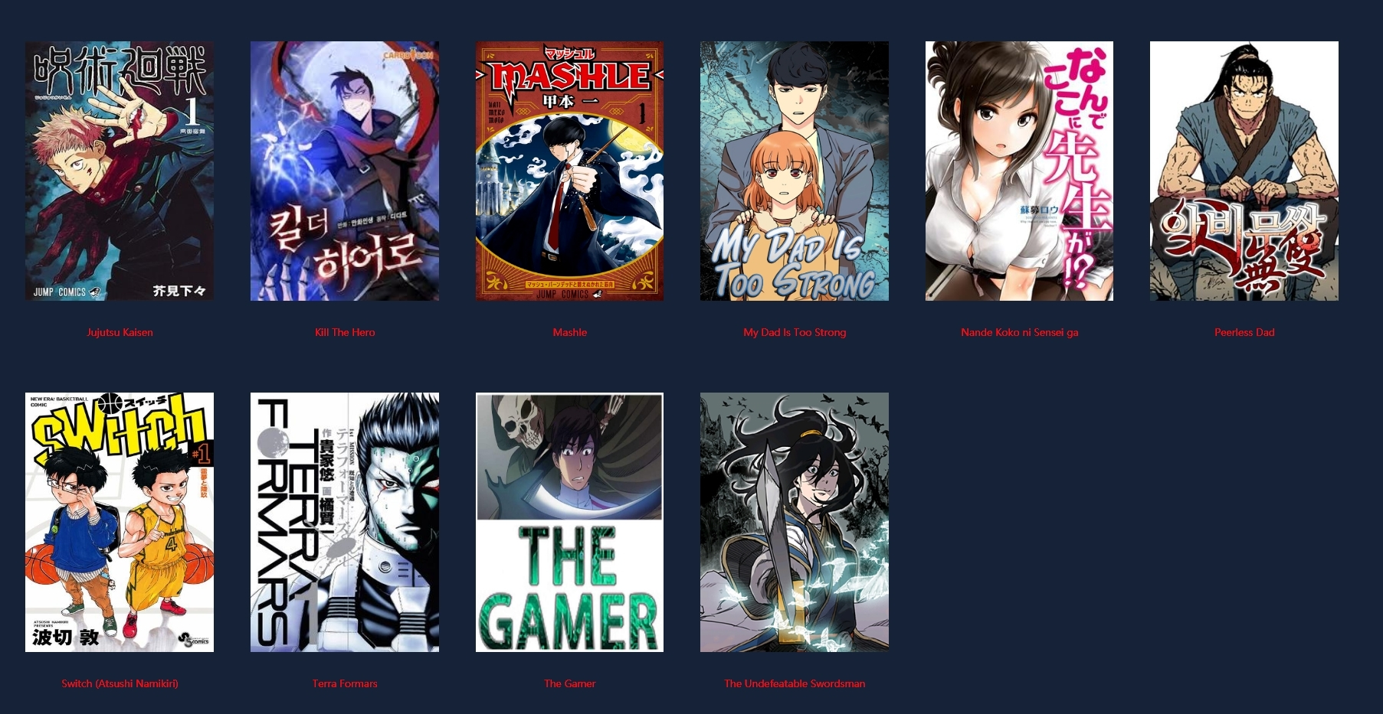
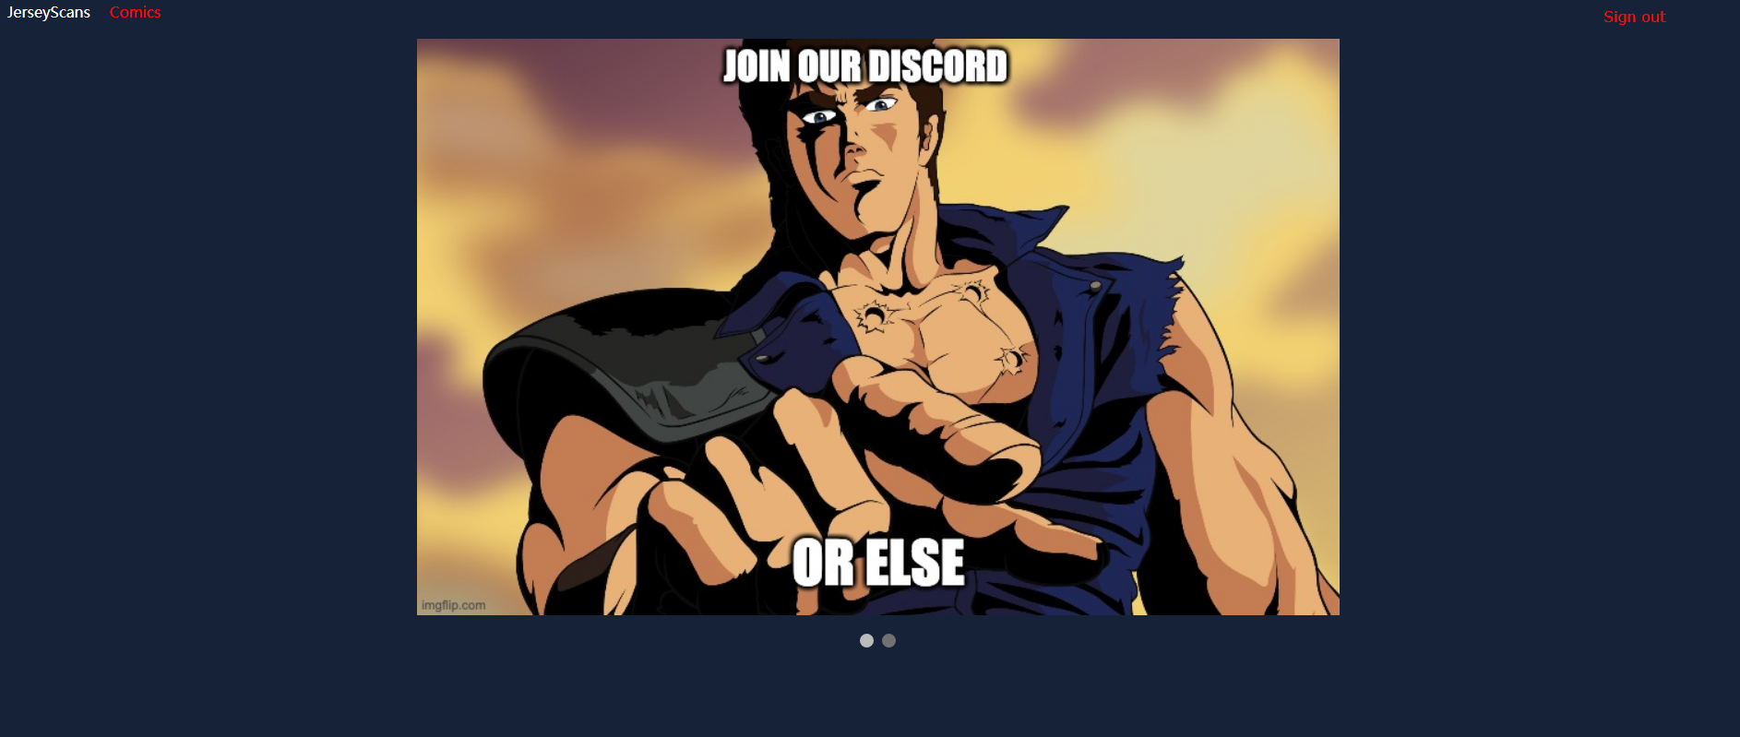
Index Sign in Page

Slide 11
Index Signed in Page
This is the index page when you are signed in.
In includes all the comics, the slideshows, and all the links.
When you now click on the comics, you will then be able to view the information about each comic

Slide 12
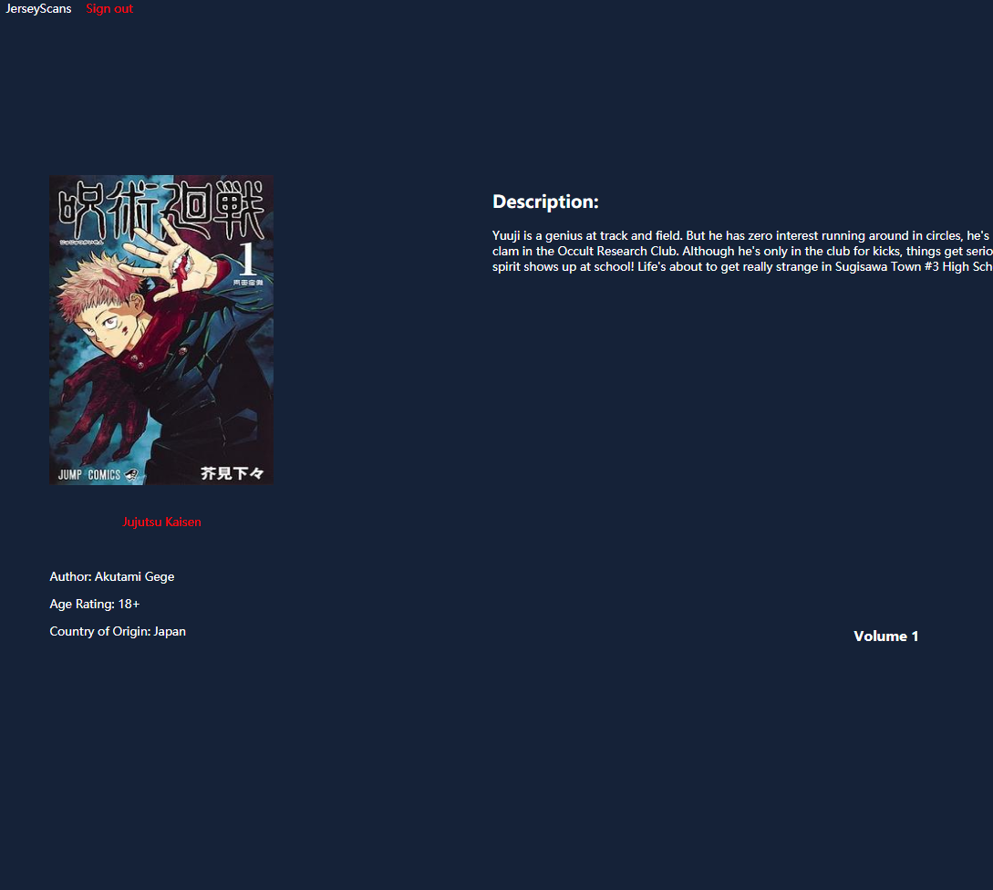

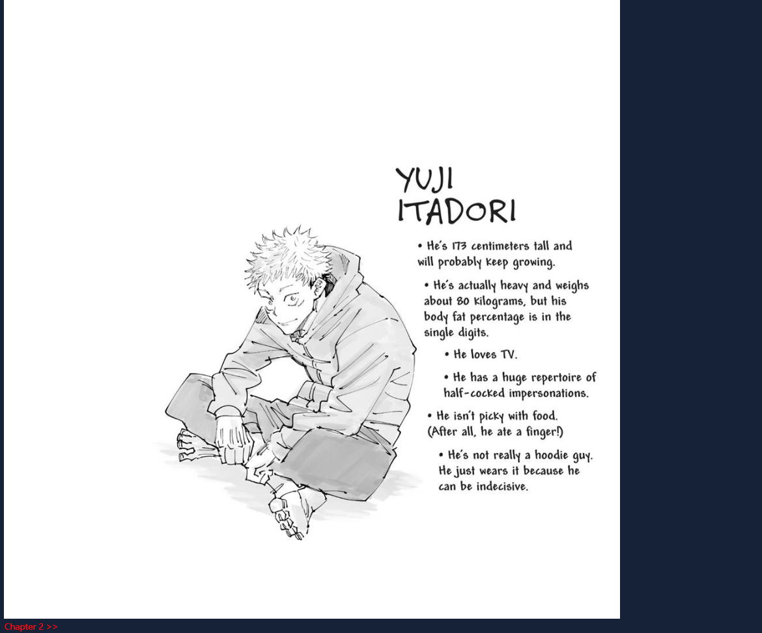
Comic Page

Slide 13
Comic Page (con).
When going into the comic page it shows the description, the image, the author, the country of origin, and the author.
We have the volumes and chapters. Currently we only have volume 1, and 5 chapters. When you click on each chapter link it will go through the said chapter like Chapter 1
When going into the chapters the pages for each manga are shown all the way till the bottom
There is also a hyperlink that clicks for the Next chapter or the previous chapter

Slide 14
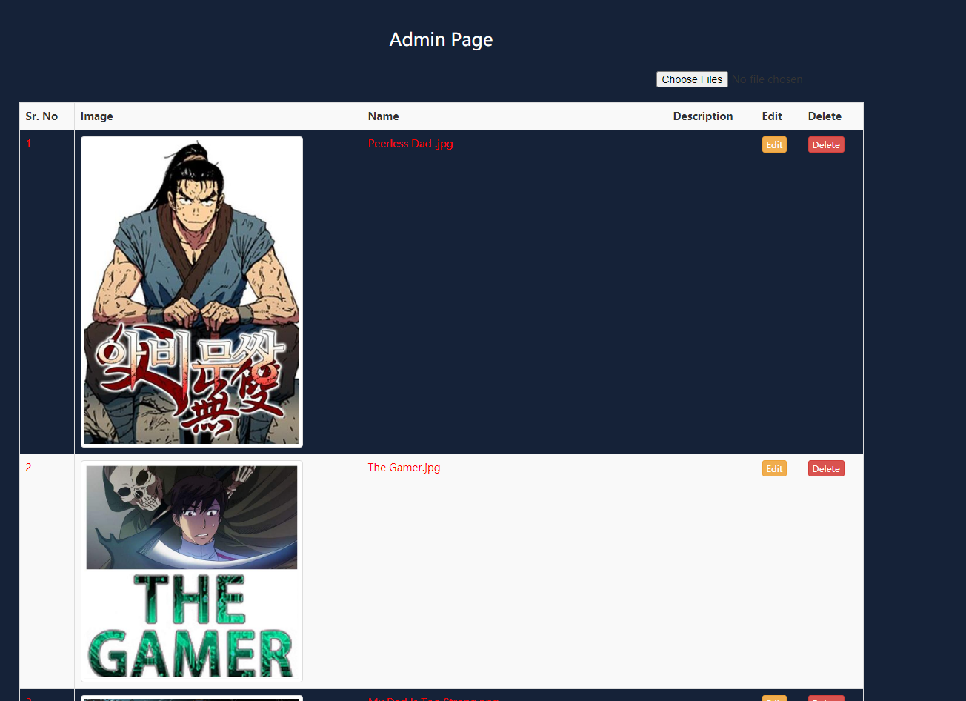
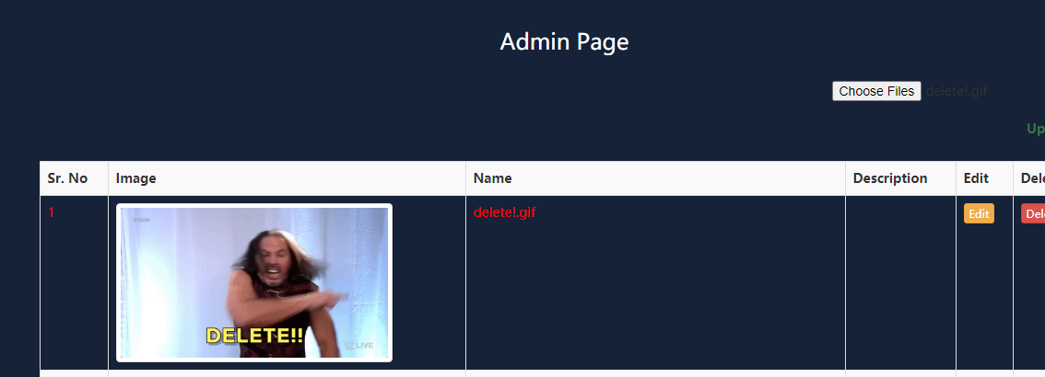
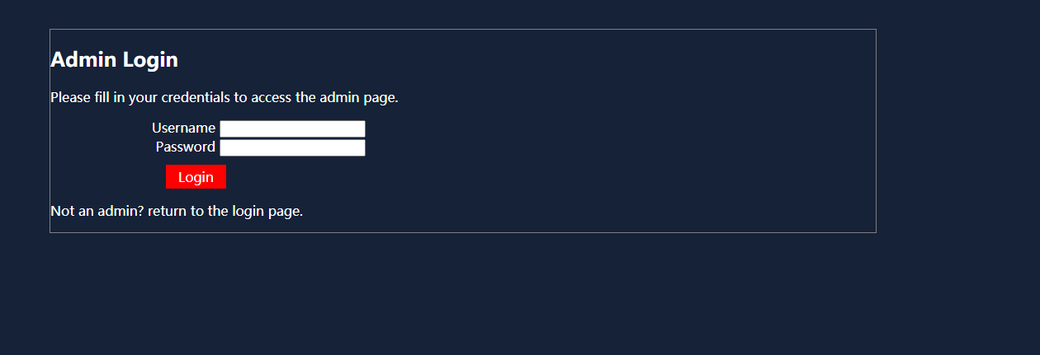
Admin

Slide 15
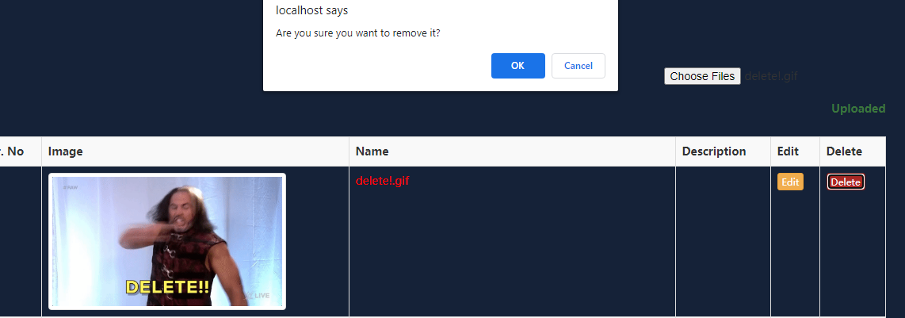
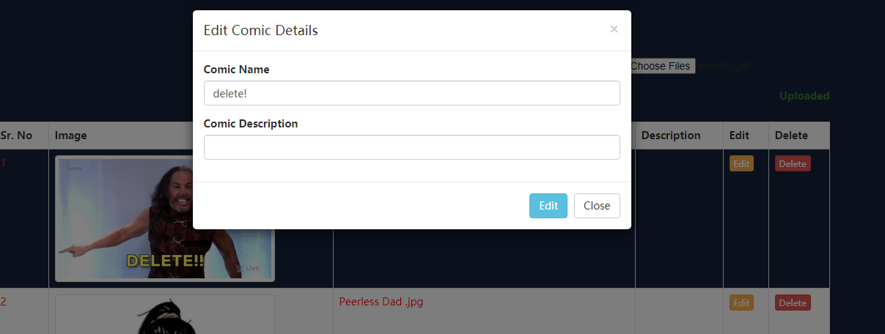
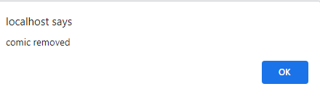
Admin (con).

Slide 16
Admin (con).
There is an admin page for this website, to sign in you would go into the same sign in and click on sign in as a admin. It’s the same process as creating the user
Once you get into the admin page you can insert pictures, remove pictures, edit the name of the pictures, and edit the description
When removing it there will be an alert asking if the admin wants to remove the picture
Inserting an image will be in the database

Slide 17
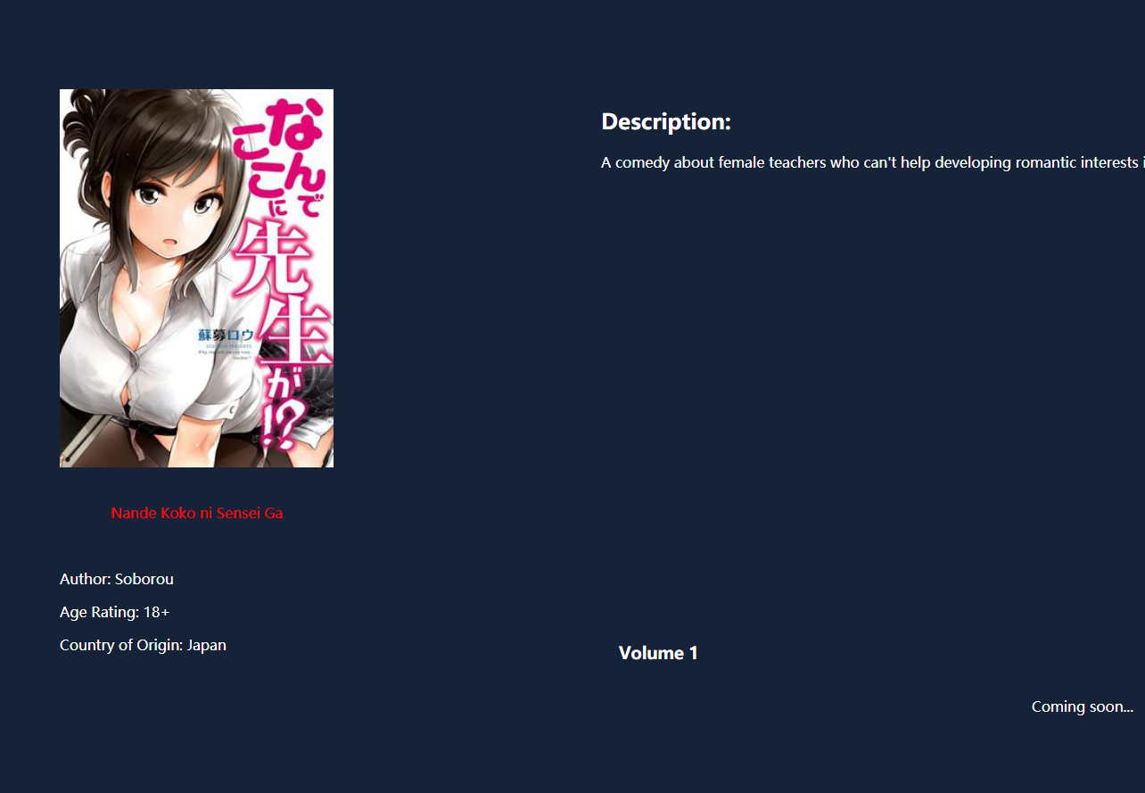
Features that we are still working on
We need to add more comics into the website. For example, we need to add the chapters for Nande Koko ni Sensei Ga unfortunately, we are not able to find any
Working on the admin page to include delete the actual comics from the database
Possibly add more to our slideshow

Slide 18
What can be improved
What can be improved is the admin page, because we can only remove the pictures of the admin page, and not the databases of the users or inserting the actual pages of the comic into the database
Need a better way to search for the comics instead of clicking of the image, we just need to put in a search bar for it
Make the pages the same length and size or have a page slideshow like our slideshow in the index page

